Slide 1
Asset Management System

Slide 2
Abstract
Save companies money and time.
Understand the capabilities of its assets
how they can be operated in the most effective manner.
Allows the organization to keep track.
It can tell
- Asset Location.
- How they are used. - Update changes.

Slide 3
Introduction
Managing assets effectively for utilities is not optional these days.
Economies are trying to identify the lowest cost / highest return investments to achieve maximum immediate benefit.
Good asset management can help in a number of ways to manage large expenditure and for this an asset register is vital.

Slide 4
Asset Management
Is about understanding and managing the risk associated with owning assets.
Information can be entered directly into the register using a tablet or other device.
Assets can also be tagged at this point, for example using barcodes.

Slide 5
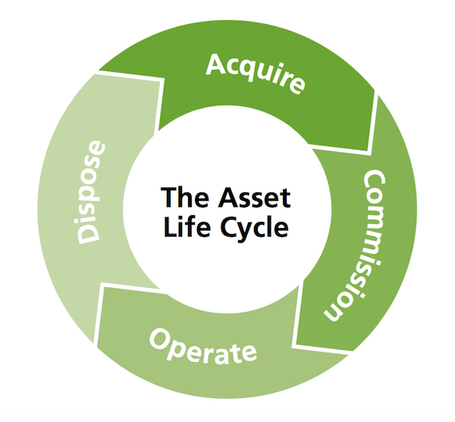
Asset Management Life Cycle
Understanding that assets have a life cycle is a key concept.
Figure 1: Life cycle of asset management

